Slide 1



COGS by Date and Country
View in Power BI
Last data refresh:
06/01/2024 18:05:17 UTC
Downloaded at:
06/01/2024 19:49:32 UTC

Slide 2
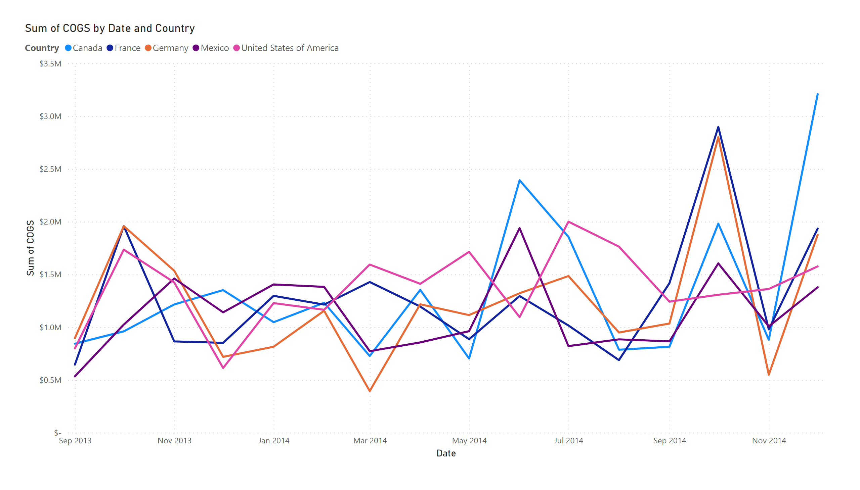
Page 2
Notes:
lineChart
No alt text provided

